Slide 1
Signals
Dr. Michael Nasief

Slide 2
Lec 2

Slide 13
Examples

Slide 14
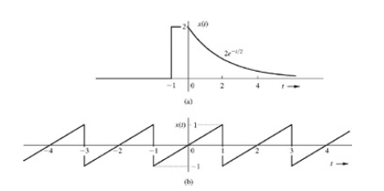
Example Find the size of each signal below

Slide 15
Example 2
Show that the energies of the signals in Fig. 1.3a, 1.3b, 1.3c, and 1.3d are 4, 1, 4/3, and 4/3, respectively.
Observe that doubling a signal quadruples the energy, and time-shifting a signal has no effect on the energy.
Show also that the power of the signal in Fig. 1.3e is 0.4323.

Slide 17
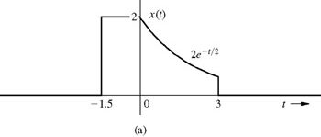
EXAMPLE 1.4
Figure 1.7a shows a signal x(t). Sketch and describe mathematically this signal time-compressed by factor 3. Repeat the problem for the same signal time-expanded by factor 2.

Slide 18
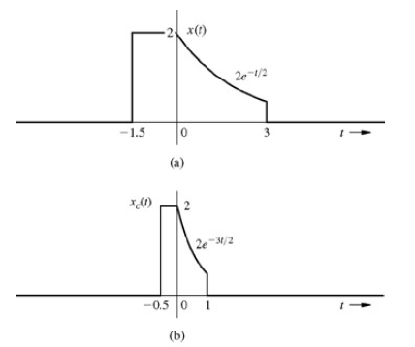

Slide 19
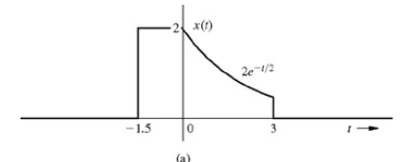
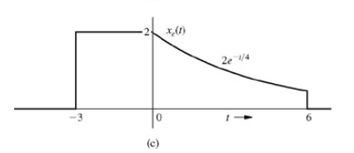

Slide 20
Bonus Quiz
EXERCISE E1.6
Show that an everlasting exponential e^{−at} is neither an energy nor a power signal for any real value of a. However, if a is imaginary, it is a power signal with power Px = 1 regardless of the value of a.

Slide 21
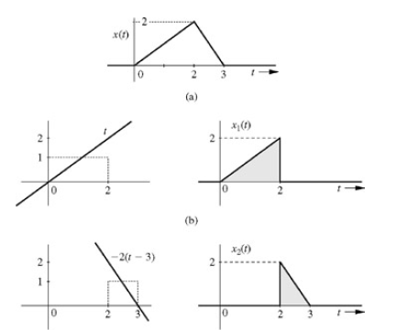
EXAMPLE 1.6 Describe the signal in Fig. 1.16a.

Slide 22
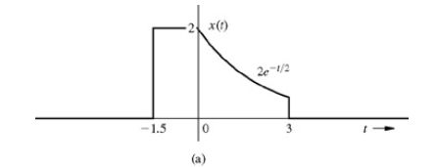
Example

Slide 23
Example

Slide 24
